Slide 1
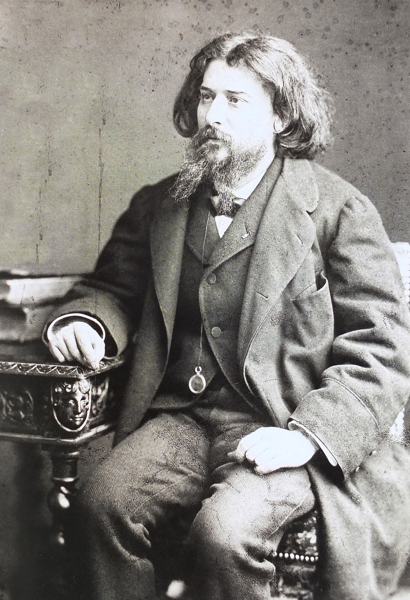
Welcome To “N.P. Tutorial”
Chapter Name– The Last Lesson
Writer – Alphonse Daudet
Today we will discuss exercises

Slide 2
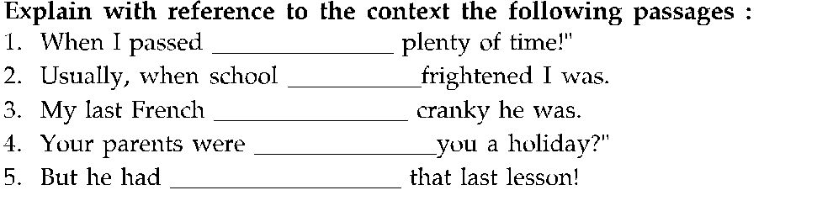

Slide 3
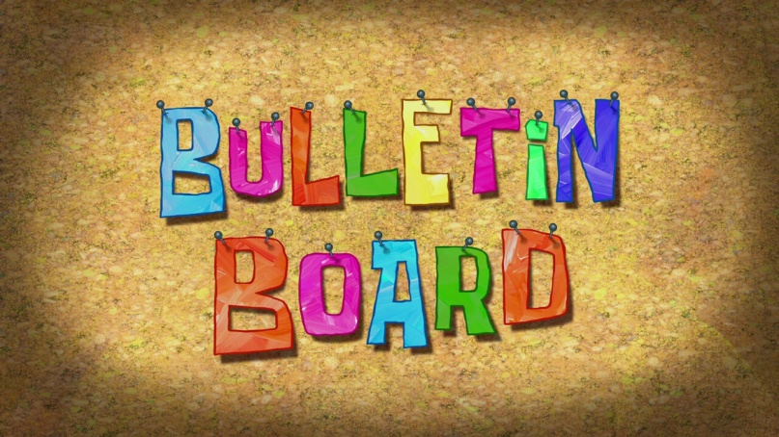
Answer the following:- Q1.What was bulletin board? How was it important?
Ans. Bulletin board was the notice board which was near the town hall.
It was important because from the last two years all the bad news as- the lost battles, the draft, the orders of commanding officer had come from this board.

Slide 4
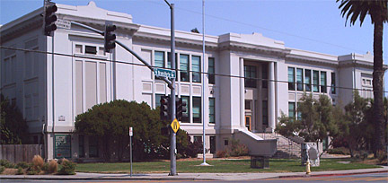
Q2. what did M. Hamel say when Franz reached to the school ?
Ans. When Franz reached to the school M. Hamel said him very kindly to go to his bench quickly as they were going to start without him.

Slide 5
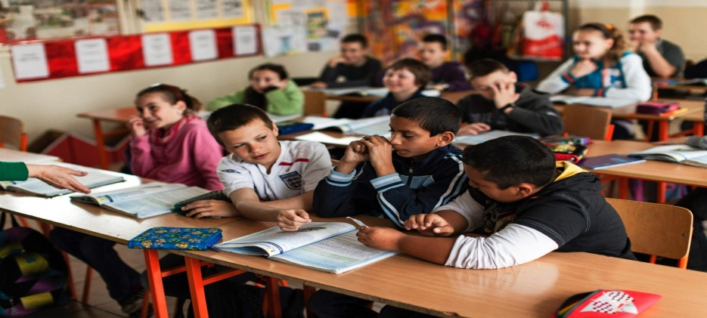
Q3. What did M. Hamel speak first in the class that day about the last lesson ?
Ans. M. Hamel spoke in the class that my children, this is the last lesson I shall give you. The order has come from Berlin to teach only German in the schools of Alsace and Lorraine. This is your last French lesson. I want you to be very attentive.

Slide 6
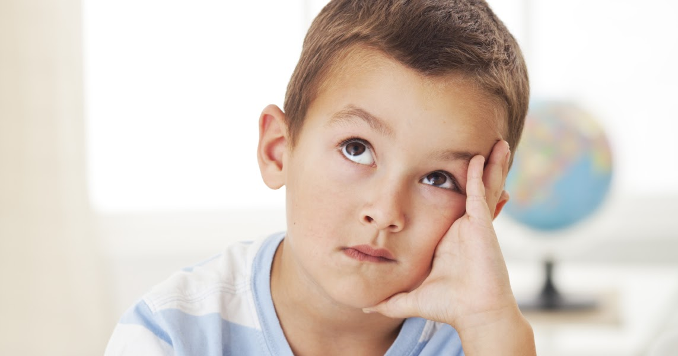
Q4. What did Franz think after hearing about the last lesson ?
Oh. No!!
Ans. After hearing about the last lesson Franz was very sorry for not learning his lessons. These words were thunderclap to him. He didn’t know how to write French. He would never learn any more. Then, he must stop there.

Slide 7
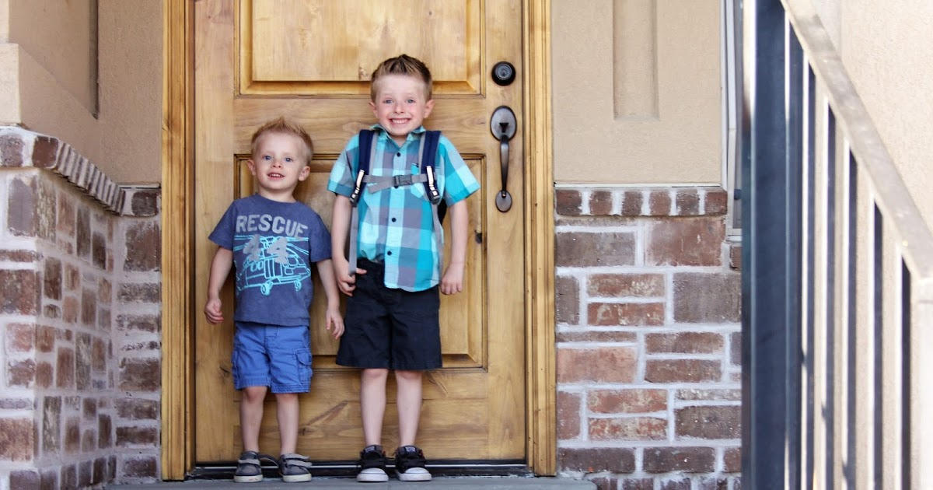
Q5. Did Franz recite the participles ? How?
Ans. No, Franz did not recite the rules of participles.
Because Franz did not know even the first word about the participles. For sometime he thought of running away and spending the day outdoors.

Slide 8
Q6. Whom did M. Hamel blame for the ignorance in studies ? Why?
Ans. M. Hamel blamed the parents as well as himself for the ignorance in studies.
Because parents preferred their wards to work on a farm or mills so that they may earn a little more money and the teacher often sent the students to water his flowers instead of learning.

Slide 9
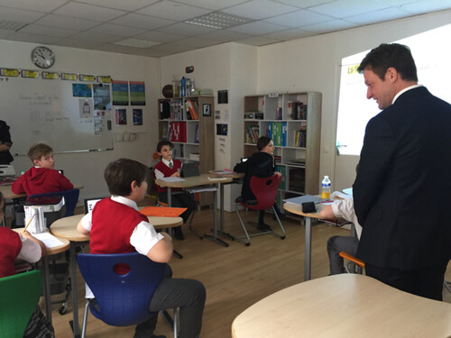
Q7. What did M. Hamel say about the language and its importance ?
Ans. M. Hamel said that we must guard our language among us and never forget it, Because when people of a country are enslaved, as long as they have full control on their language it is as if they had the key to their prison.

Slide 10
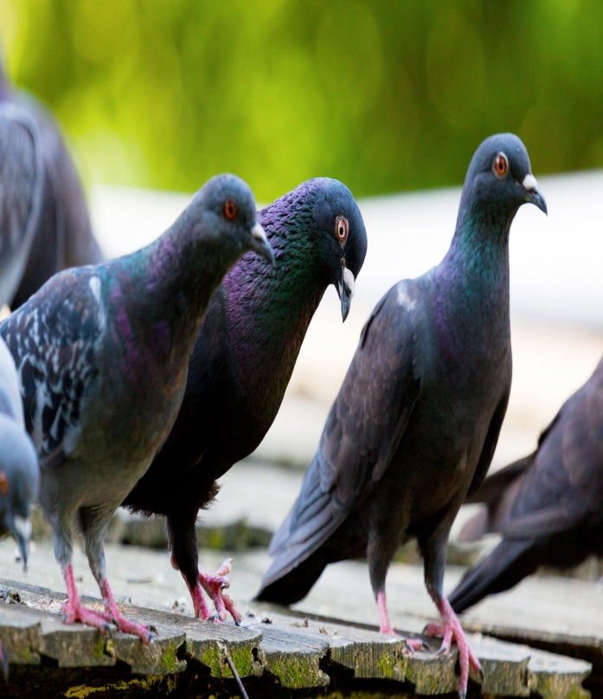
Q8. What did Franz think about the pigeons ? Why ?
Ans. When the pigeons cooed on the roof Franz thought if they will make even the pigeons sing in German.
Because the order from Berlin had come to teach German instead of French in the schools of Alsace and Lorraine.

Slide 11
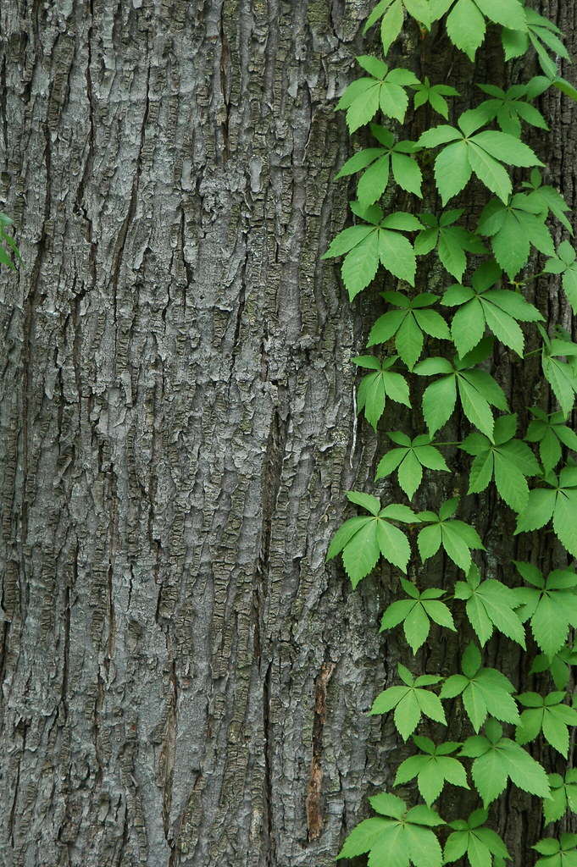
.Q9. What did M. Hamel Observe there at last ?
Ans. At last M. Hamel observed that the walnut trees in the garden were taller, and the hopvine that he had planted himself went up to the roof through the window.

Slide 12
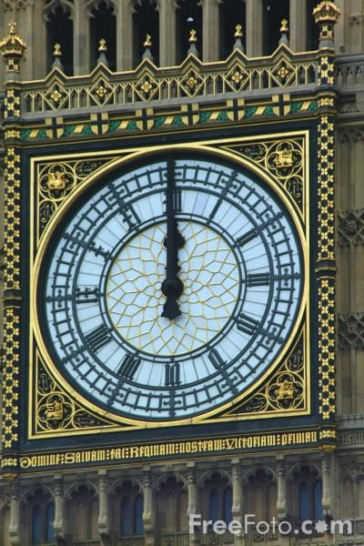
Q10. What happened when church-clock struck twelve?
Ans. When the church clock struck twelve the trumpets of the Prussians, returning from drill, sounded under the classroom windows. M. Hamel stood up very sadly from his chair.

